Slide 1
Analysis of the Lending Club Loan data set

Slide 2
Methods of EDA :-
Importing Libraries
Reading the data set
Data Frame shape and type analysis
Removing NA cells
Type casting
Outlier analysis
Analysis the data (Univariate & Bi variate)

Slide 3
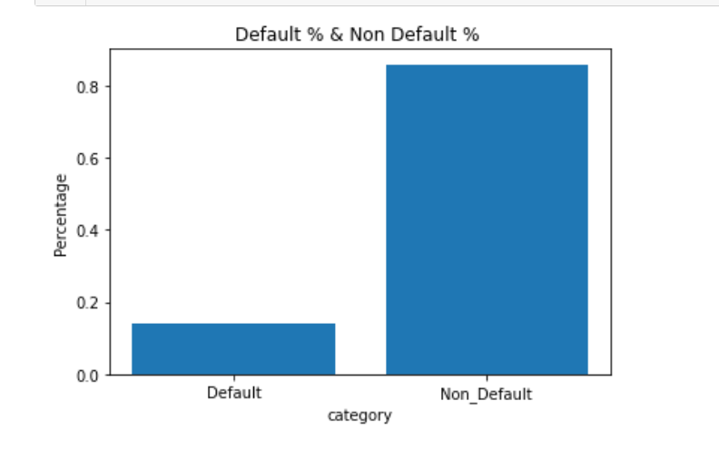
Analyzing % default and non default applicants
Default-14%
Non Default-85%

Slide 4
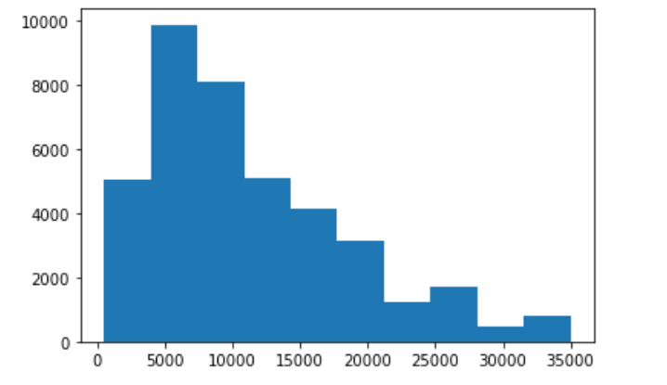
Analyzing loan amount category - high application
5000 to 10000 is the most opted loan bucket

Slide 5
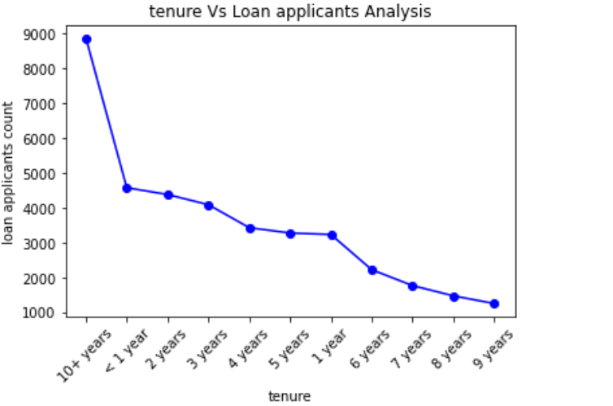
How the tenure affects the loan amount
More applications are coming from the 10+ years exp applicants

Slide 6
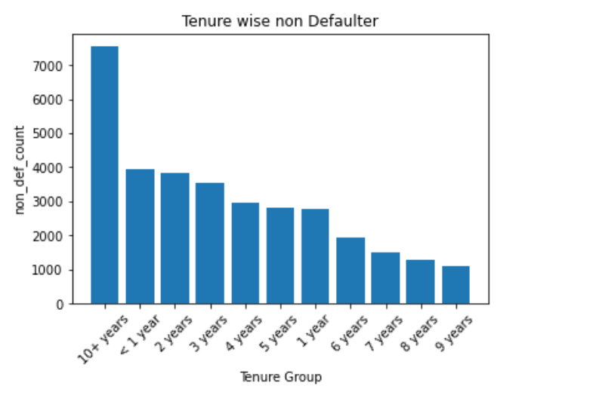
Tenure Wise Non-Defaulter analysis
Individuals with over 10 years of experience have a lower default rate compared to those with 2-9 years of experience.
Additionally, those with less than 1 year of experience tend to successfully complete their loans

Slide 7
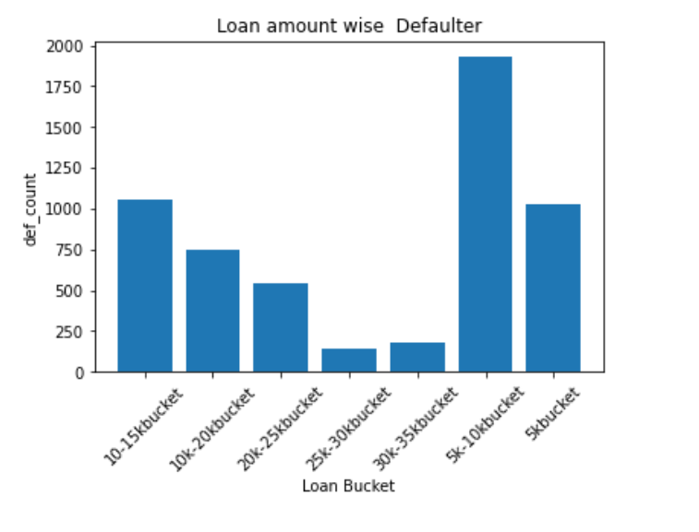
Loan Amount wise Defaulter analysis
From the below viz. it is understood people who opt for loan amount 5k to 10k are more likely to default the loan refund

Slide 8
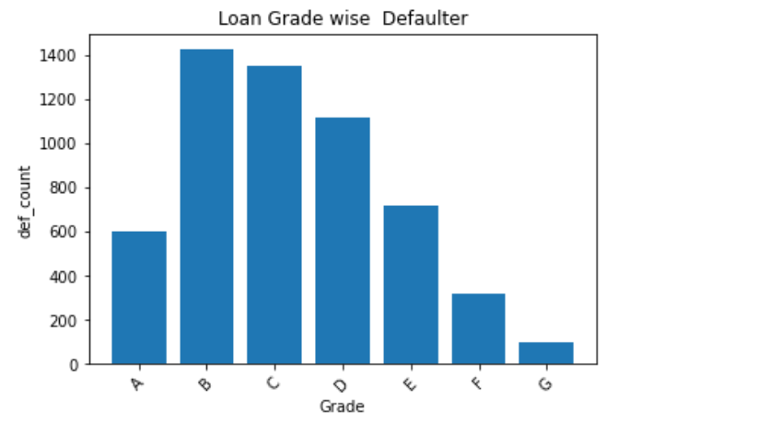
Loan grade wise defaulter analysis
From the below viz. it is understood people are of Loan Grade B & C are more likely to default the loan refund

Slide 9
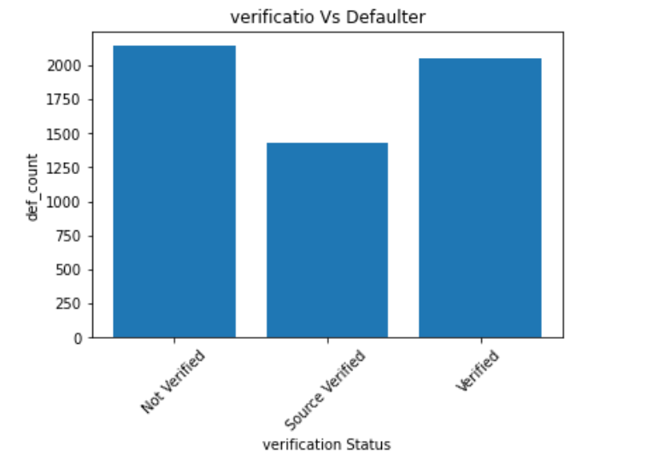
Verification status wise defaulter analysis
Source Verified applicants are less likely to default the loan

Slide 10
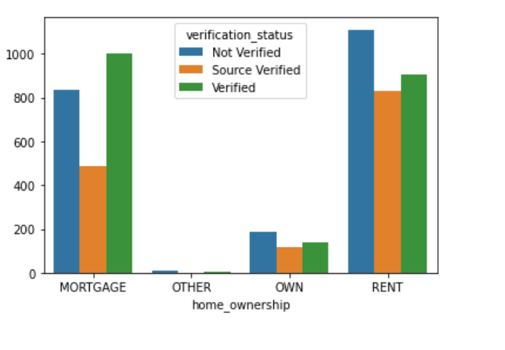
Home ownership vs verification status vs loan defaulter
MORTGAGE & RENT applicants are more like to be defaulter.
With in that verified and Non-verified are more likely to be defaulter than Source Verified . Means LC should verify the source of income of applicants not just income

Slide 11
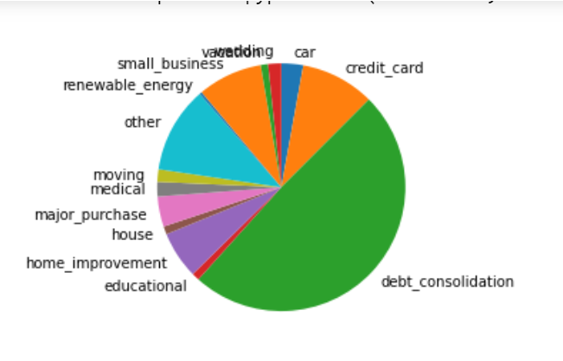
Purpose vs loan defaulter analysis
debt-consolidation & credit card & other loan purpose applicants are more like to be defaulters

Slide 12
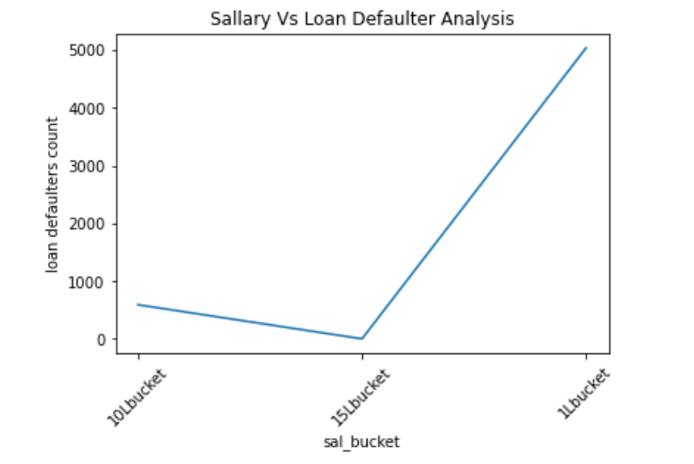
Salary range vs defaulter analysis
From Defaulter data, applicants between 1L to 10L salary are more likely to default . the default case gets reduce by the increase of salary

Slide 13
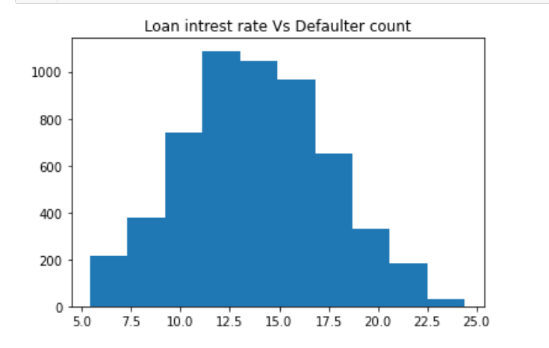
Interest rate vs defaulter analysis
12.5% to 17.5 % loans are most likely to be defaulted more as compared to remaining interest %.

Slide 14
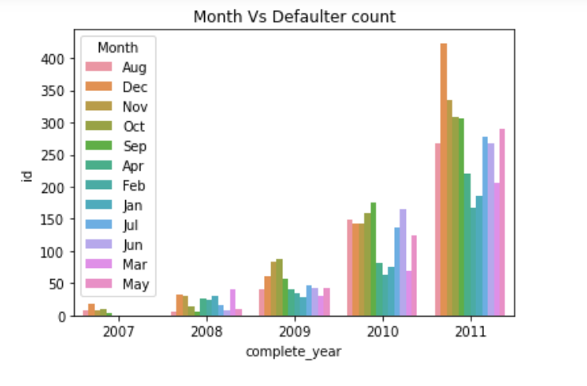
Loan issue month ,year vs defaulter analysis
2011 Year has most defaulter and that to in the month of Dec. And year by year the defaulter count is increasing .

